Slide 1
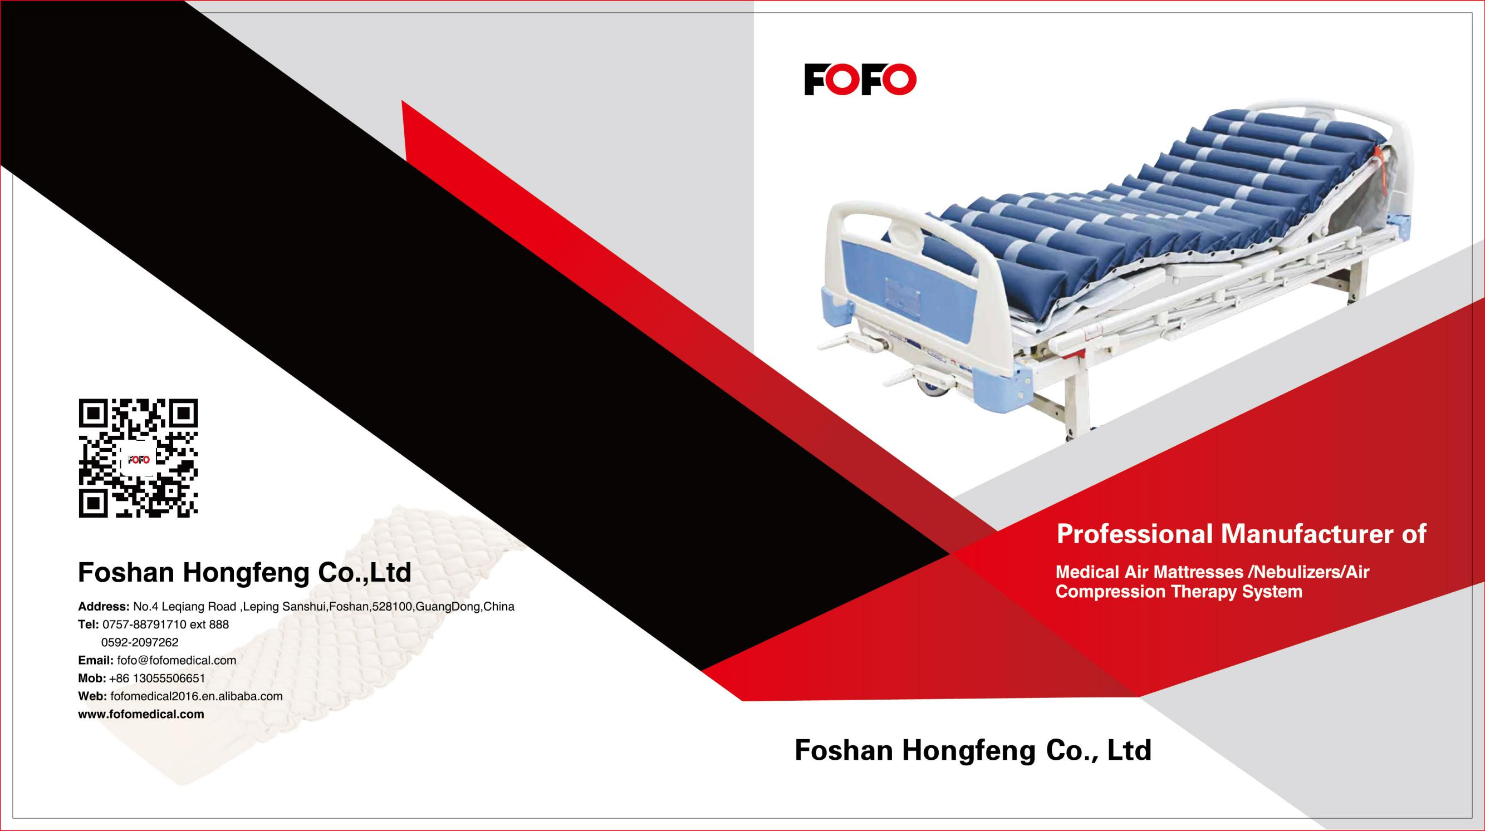
FOFO MEDICAL

Slide 2

Foshan Hongfeng Co., ltd
Quickest become one of the Top 3 Mattress manufacture in China/Taiwan within 3 years
High frequency experience 15 years OEM/ODM with world top brands.
225KW high frequency machine with 4 operation slide ：one -time moulding bubble air mattress
180 employees including 6 QC, 5 engineers.
Main products: Medical air mattress, air cushions , water bed , sleeves for DVT
Factory ISO13485 ,CE, FDA , FSC,CFDA approved.
R&D department involve in high frequency molds design, supplier parts engineering and checking, new product development.
100% inflating test for QC , make sure products warranty 12 months
Taiwanese material PVC / TPU top quality use

Slide 3

Professional on High frequency welding technology and facilities, over 20 welding machines, professional engineer with over 30 years experience and patented technology.
Completed cutting --printing --high frequency -- sewing --packaging lines
Good OEM/ODM ability and experience, over 15 years OEM/ODM experience with world famous brands.
Strict Quality Control policy 100% inspection and QC pass
Our Advantages

Slide 4
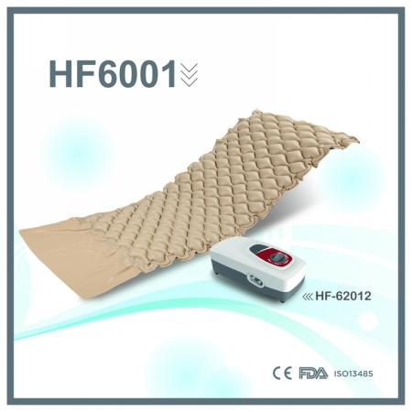

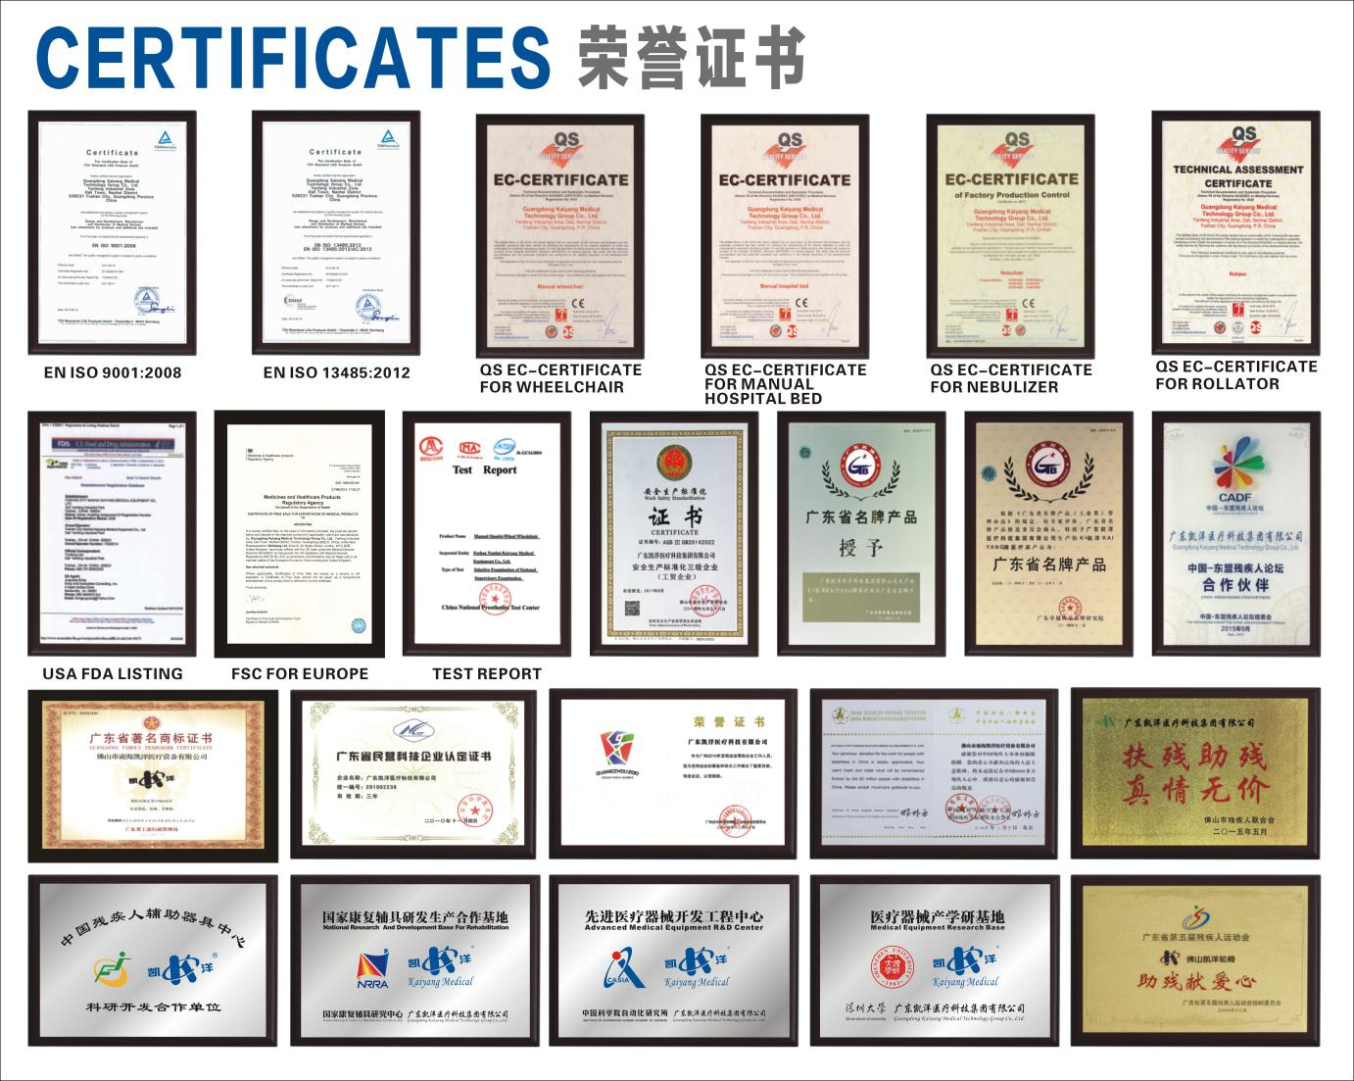
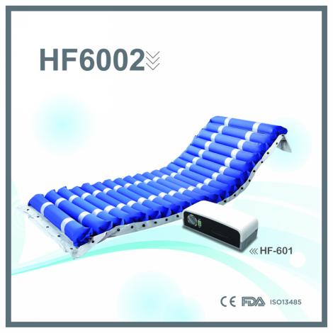
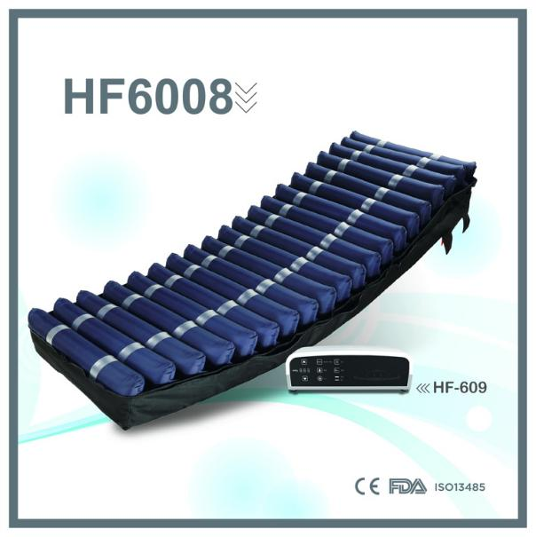
CERTIFICATION

Slide 5
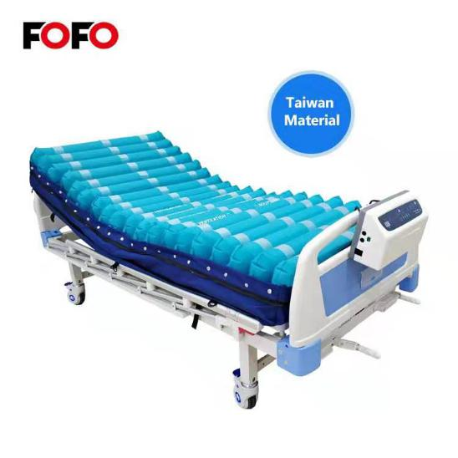
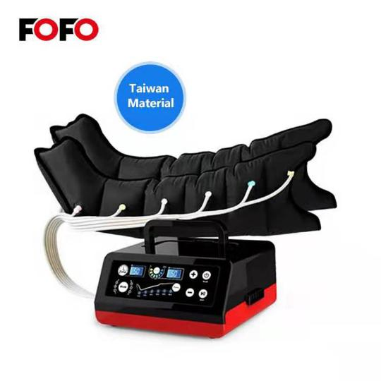
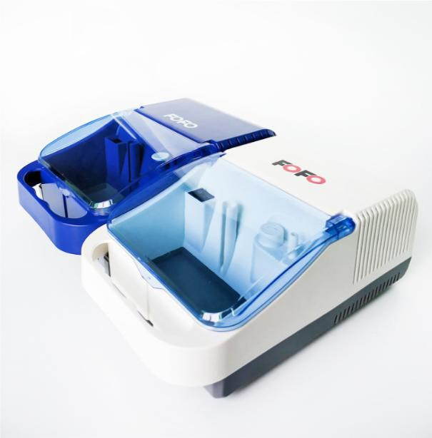
Mattresses
Nebulizes
SCD system
We are manufacture produce high quality medical air mattress for anti-bedsore , Compressor Nebulizer , Suction machines , air compression therapy for DVT .
Branding orders for over 40 countries include Europe , Japan , USA ...
Taiwanese Material

Slide 6

ALTERNATING PRESSURE MATTRESS WITH PUMP
MATTRESSES
ANTI-DECUBITUS
Our medical anti-decubitus mattress made of taiwan Nanya / Dingzing（PVC/ TPU） ,One-time moulding for bubble type mattress . Offer a variety of woundcare solutions for the treatment and healing of pressure ulcers. Give mattress warranty 12 months and compressor 18 months . Top quality aluminum compressor provide very silent and durable , big air output advantage .
From bubble 2.5” overlapping to 5” and 8” , 5+ 3” foam base . New model with toilet hole for more practical use for disabilities .
CPR , strength/ PU cover , static pillow , laser holes , toilet hole replacement cell and repair kit are optional .
TAIWANESE MATERIAL

Slide 7
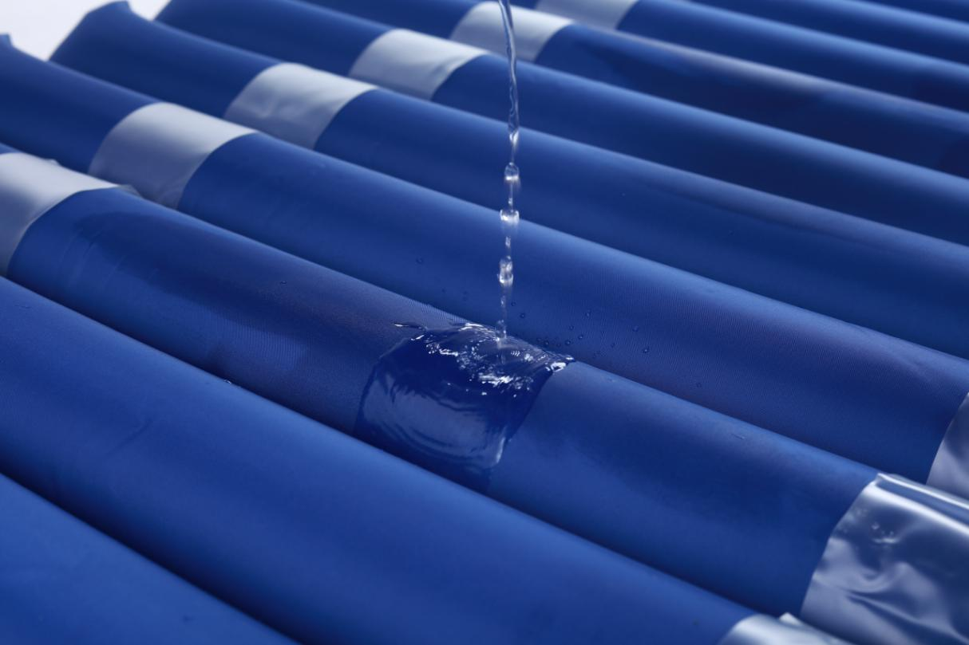
TUBULAR MATTRESSES
Class II-III
HF6002- 3“，3.5”，4.5“ ，5”
16,17,18,22,24cells 3”4.5" in PVC material top/ bottom cover , CPR , ventiltation
Class III
HF6005: zipper strech cover
18 cells 4.5" in TPU coating ; zipper PU strength cover , CPR, pillow , vented。
Class IV/V
HF6008 /HF6006 : 8” and 5+3”
cell on cell in TPU ;zipper PU strenghth cover ; CPR; pillow , vented

Slide 8
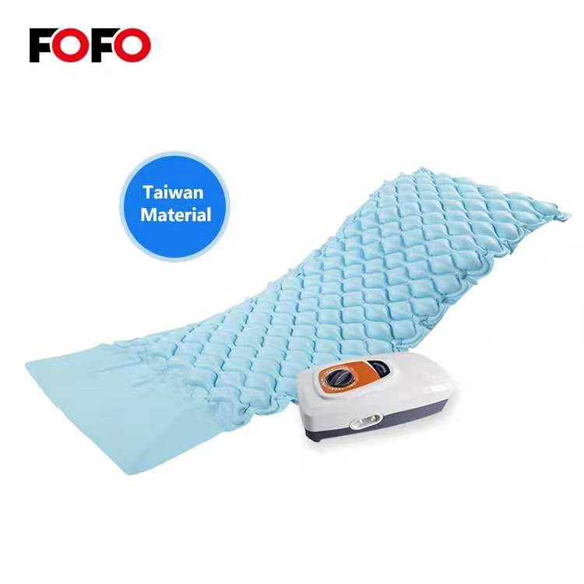
Bubble Air Mattress
Taiwanese Material
225KW HR one -time moulding
Taiwanese Bubble air mattress ( Nanya PVC 0.3mm)
- size: 200*90*7cm ,flaps , fire retard SGS
- material: Medical class PVC 0.3mm taiwanese
- with double hose , repair kit
- 225KW HR welding machine ,one time moudling producing
20 years HR-welding experience

Slide 9
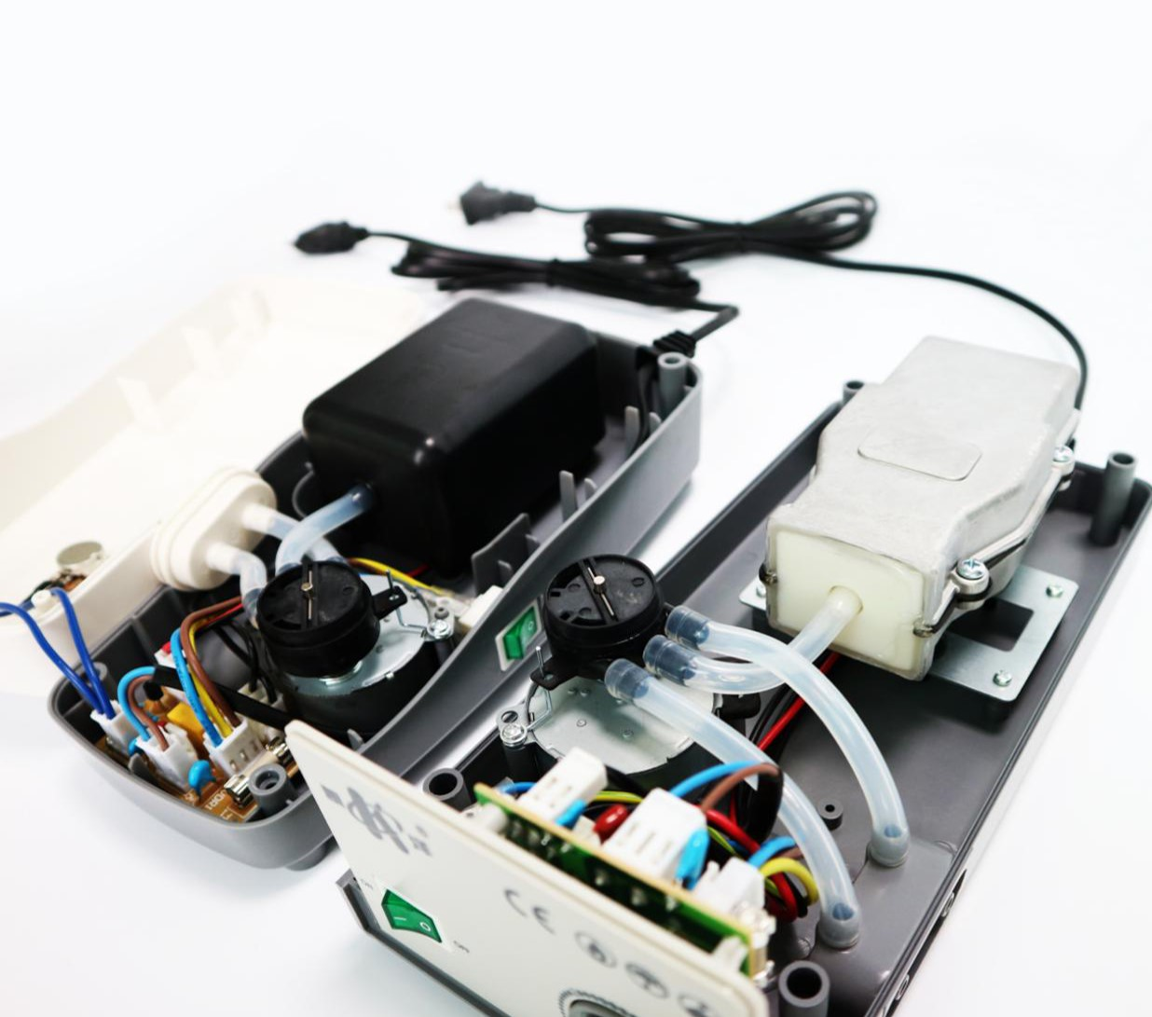
Aluminum Pump Case
Below 20db noise
Give 24 months warranty
CPC quick release and hold air if power off
AB or ABC alternating
filter / fuse outside more safe and longer life

Slide 10
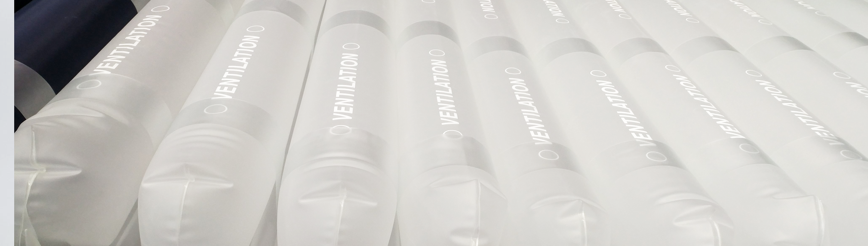
MATTRESSES REPLACEMENT
HF6008 -8” cell on /in cell mattress replacement
H6006 5+3” foam base mattress replacement
Double layer 8” mattress system : Digital aluminum pump system /AB,ABC alternating option
Auto pressure / Auto Kg control , Static , sitting , alarm /lock
Double layer air mattress with foam base layer system :Digital aluminum pump system /AB,ABC alternating option
Auto pressure / Auto Kg control , Static , sitting , alarm /lock

Slide 11
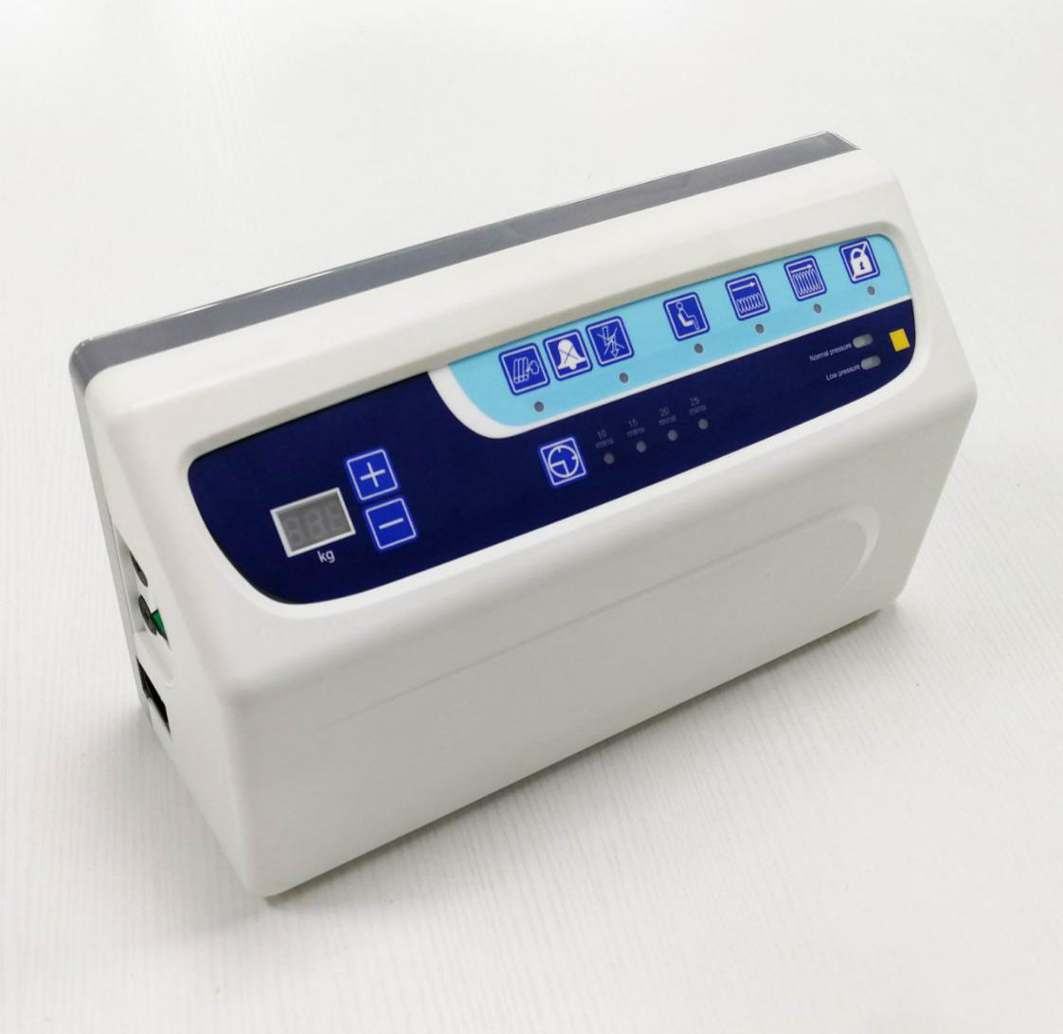
Air Pump
Auto-weight
12L/min
Digital aluminum pump system /AB,ABC alternating option
Auto pressure / Auto Kg control , Static , sitting , alarm /lock
Double Air compressor supportive more powerful

Slide 12
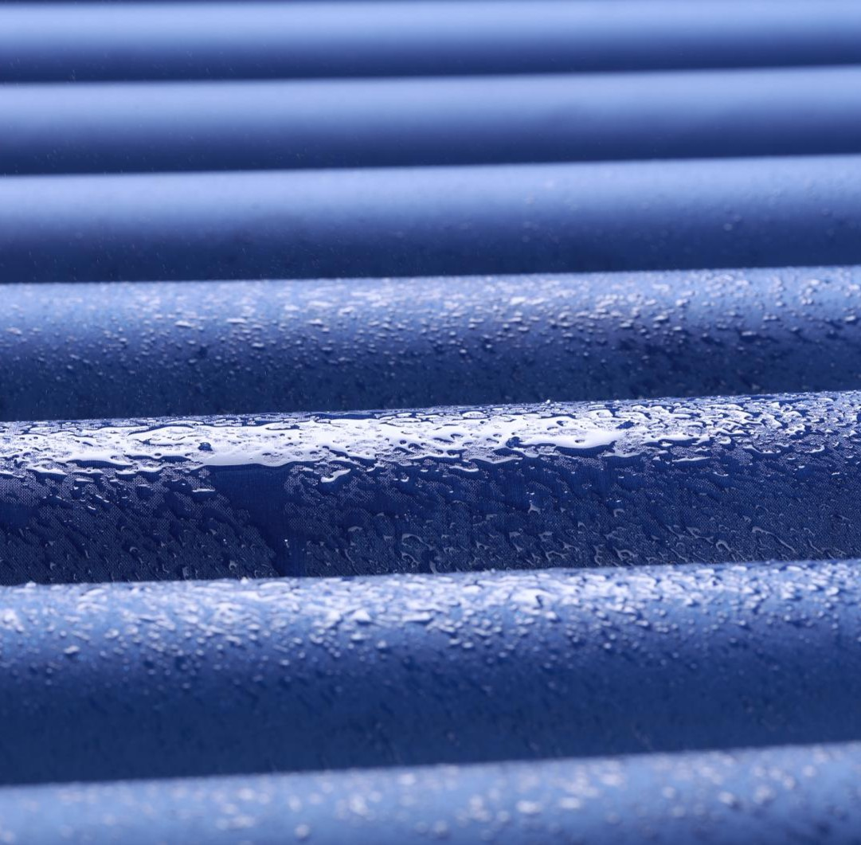
TUBULAR MATTRESS OVERLAY
20 years HR-welding experience
CPR/Ventilate
Multipal choice Tubular mattress series cover from 3” to 5” diffirent types .
7.5cm/3” cell alternating mattress with pump with low air loss holes provide good ventilation , keep users skin dry , less risk for bedsore
Movable door for fecal and urine give more options for users
11.5cm/ 4.5” tubular mattress is most popular in European market which covers most of fuctions and good choice for tender

Slide 13
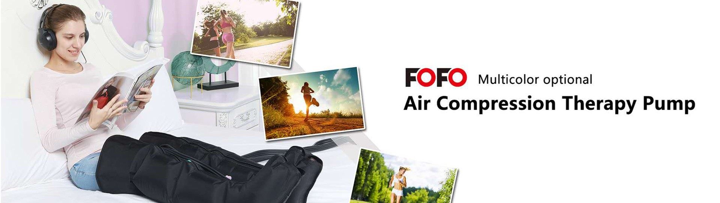
IPC/SCD Recovery System
4-6-8CHAMBERS AVALIBLE
Part of application field:
1.) Lymph edema related therapy 2.) Slimming & contouring 3.) Anti DVT 4.) Pressure therapy.
5.) Stimulate blood flow & improve poor circulation 6.) Diabetes foot 7.) Post surgery recover. 8.)sport injury recovery

Slide 14
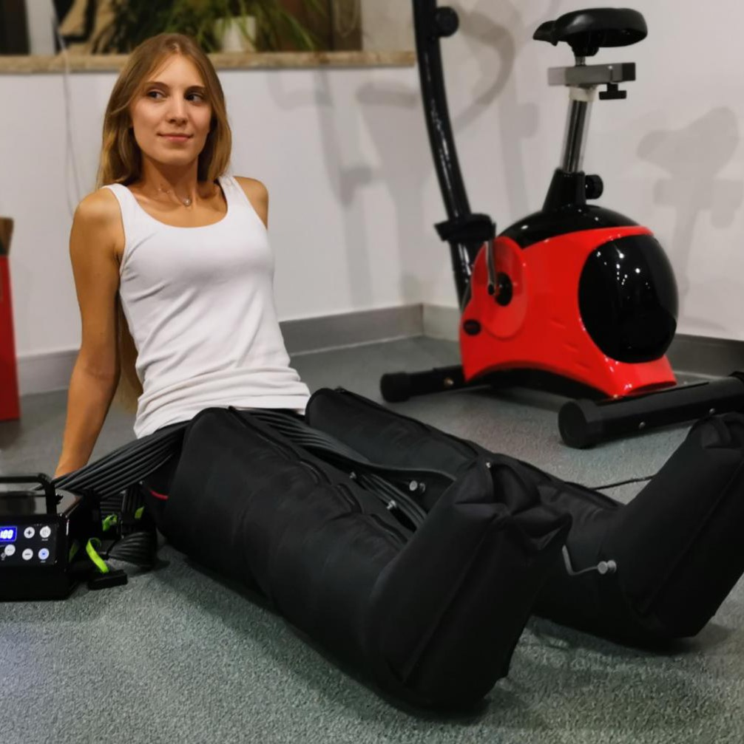
RECOVERY BOOTS
Cuff Sleeves
Leg , Arm ,Waist , short pants,Long pants
Chambers
Manual /Didital
4-6-8 chambers
Electric Supply
AC supply powerful
DC/ Battery rechargable portable

Slide 15
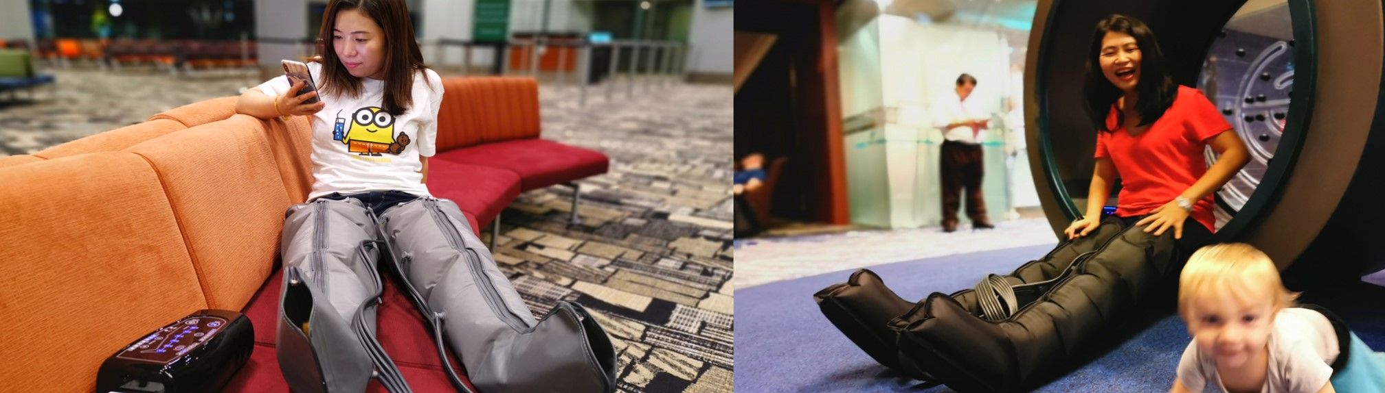
Travel Story
Using at airport
Using after Gym
Our teams use this air compression system doing massage treatment after 13 hours fight to New york
Make stress relief quickly and recovery in 15 mins
Every time after sport treatment , this device is fantastic for engery recovery back
New battery supportive portable machine more suitable for sportman travel out even in sportgroud outside without power

Slide 16
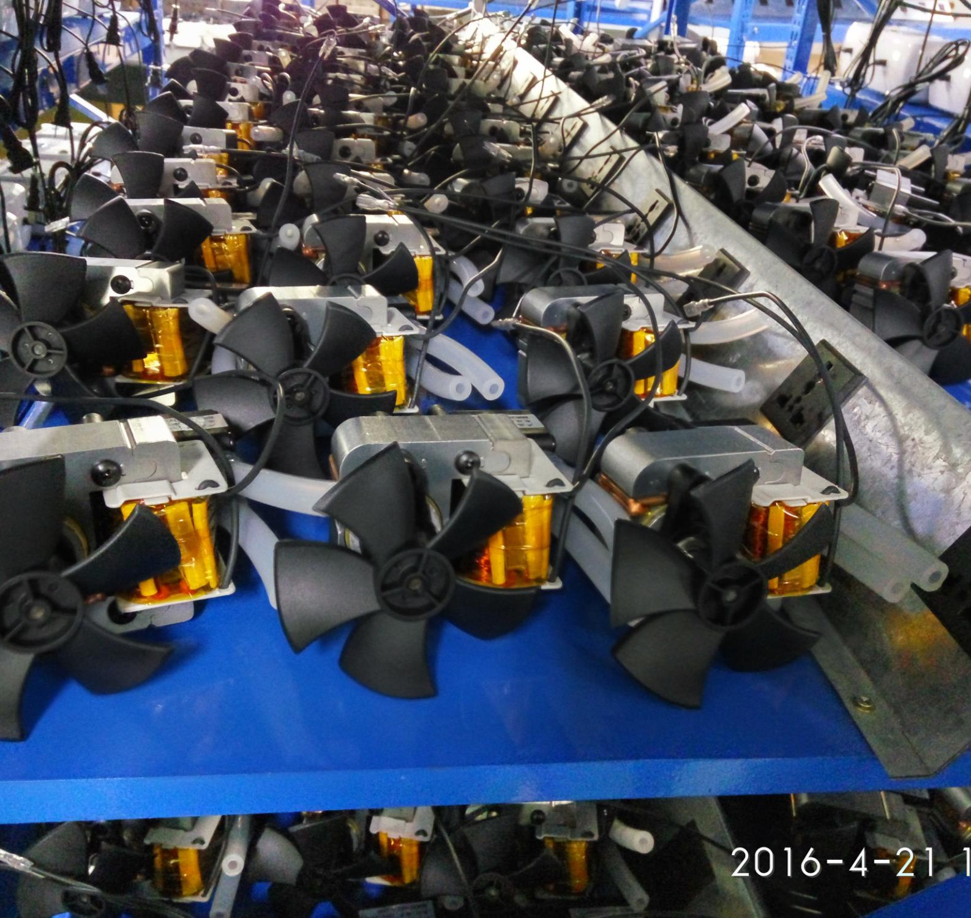
COMPRESSOR
Innovated high technology compressor providiing our trustable high quality Nebulizer and Suction machines.
Consulted by Iseal Engineers and have 10 years professional compressor manufacture experienced .
Brings our Compressor not only used by our nebulizer /suction but also for world wide manufactures as us a relieable suppiler
COMPRESSOR MANUFACTURE
Nebulizer /Suction

Slide 17
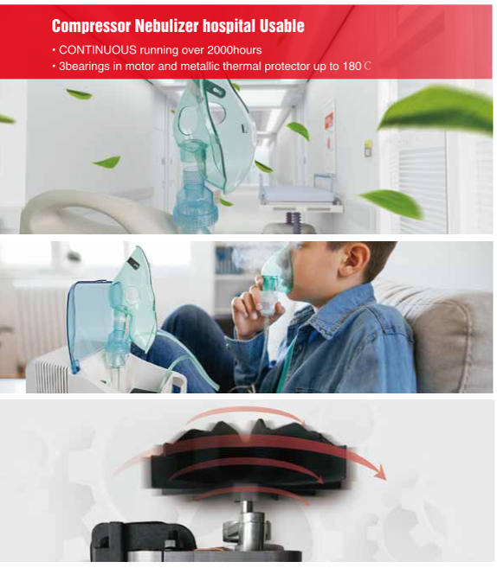
NEBULIZERS
-continuous running 2000 hours testing
-3 bearings in motor and metallic thermal protector (not disposable plastic type )
- FDA ISO 510K certificates
Hospital Usable
3 years warranty
Durable compressor
3 bearings in motor and metallic thermal protector (not disposable plastic type )

Slide 18
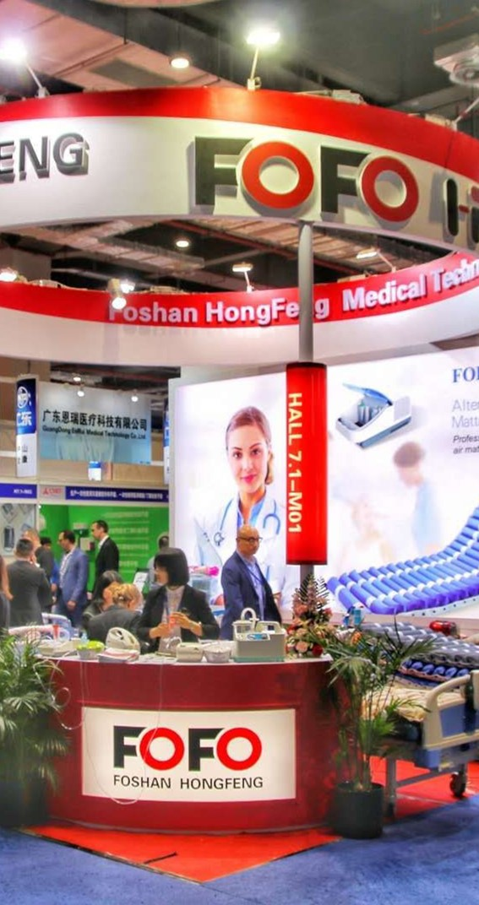
1
Foshan Hongfeng :
high frequency production
FOFO
Mattresses / air compression leg cuffs / water bed / air cushions
2
Xiamen Healthreach :
Electric device and parts manufacture
Factory located in Foshan and Xiamen
Medical air pump, Air compression pump, Nebuilizers , Suctions and parts of machines
We are manufacture produce high quality medical air mattress for anti-bedsore , Compressor Nebulizer , Suction machines , air compression therapy for DVT .
Branding orders for over 40 countries include Europe , Japan , USA ...
3
FOFO medial:
Head office
Located in beautiful Xiamen island , near Taiwan . in charge of management , marketing , purchuse and R/D team

Slide 19
BUSINESS STATUS
FOFO MEDICAL
40
1500
180
16000
Export countries
Millions USD in 2018
Labors
Square meter
Above data from 2018 finicial report . cover Foshan and Xiamen branches

Slide 20
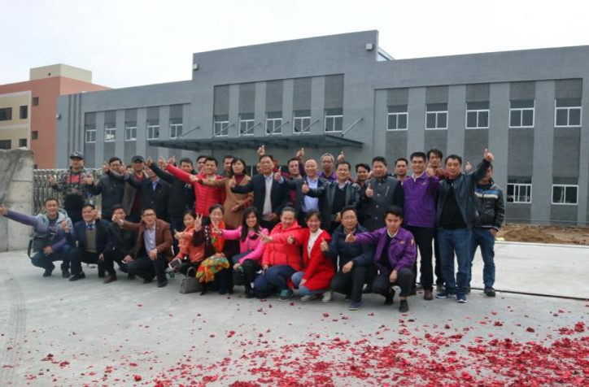
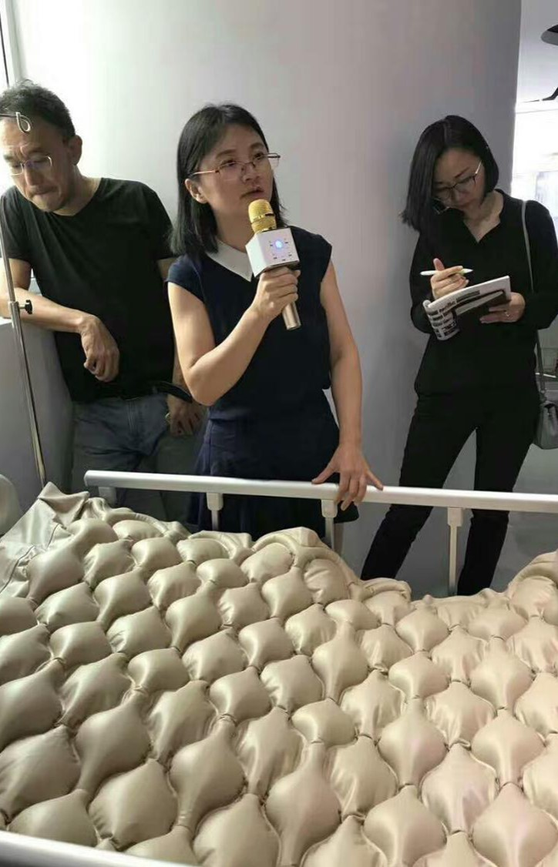
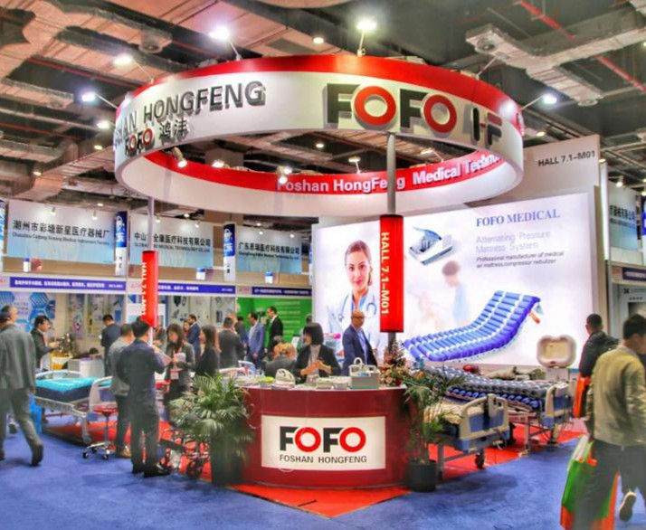
10000 Square meter Professional Medical air mattress Factory
Management
Joint ventured with Top 1 wheelchair factory in China Guangdong Kaiyang
Worldwide Medical shows
Arab health ; Medtrade , FIME , Medica, Rehacare , Canton fair , CMEF ,covering USA , European , Middle east , Asia markets
Trainning
Educating and trainning for company coworkers
Going to Customer company give tranning in the same time

Slide 21
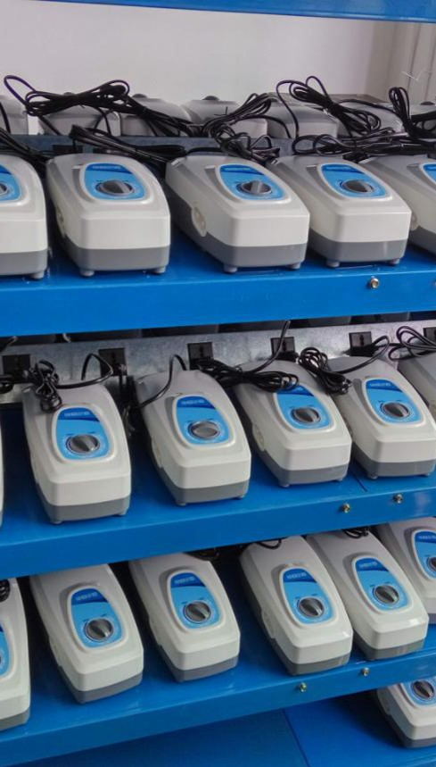
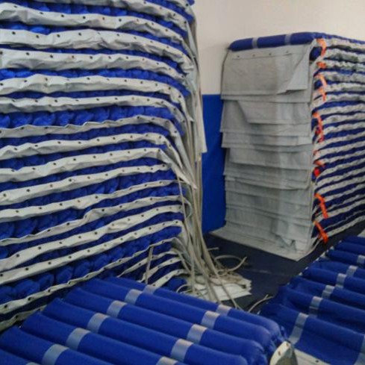
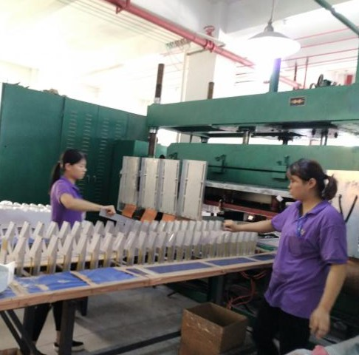
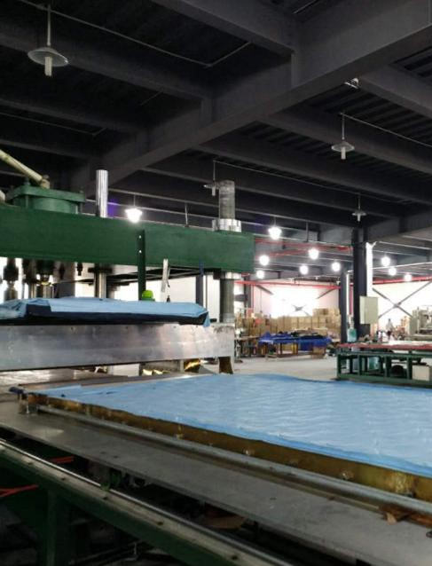
225KW High freuquency machine
Patented Biggest high frequency machine can produce Bubble mattress in one-time one moulding
Double Voltage auto-fit pump
Patented Double voltage Auto-ajustment pump for safty use for Brazil market
Double layer 12cm bubble mattress
Patented Double layer 12cm bubble mattress for European tender designs
100% inflating QC before ship
Pump and Mattress keep 100% aging running QC stay 6 -12 hours before package
Defect Rate below 0.7% after use 1 year

Slide 22
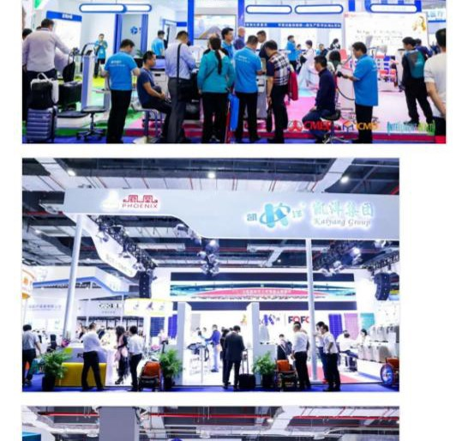
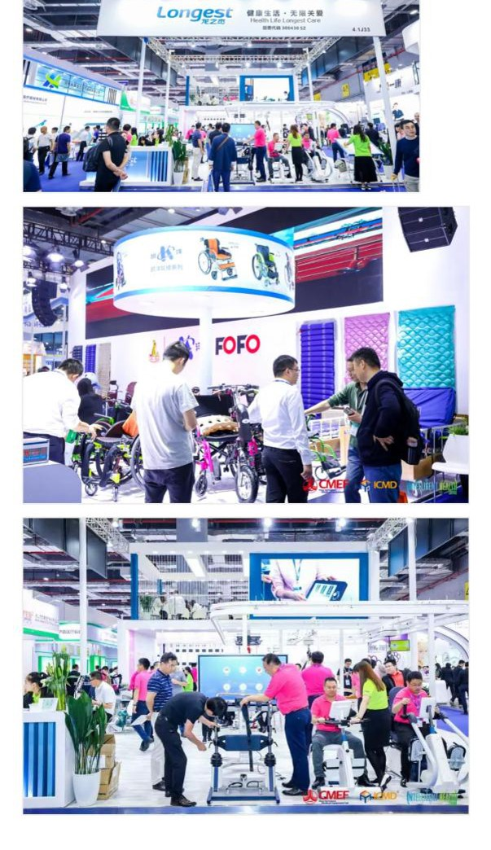
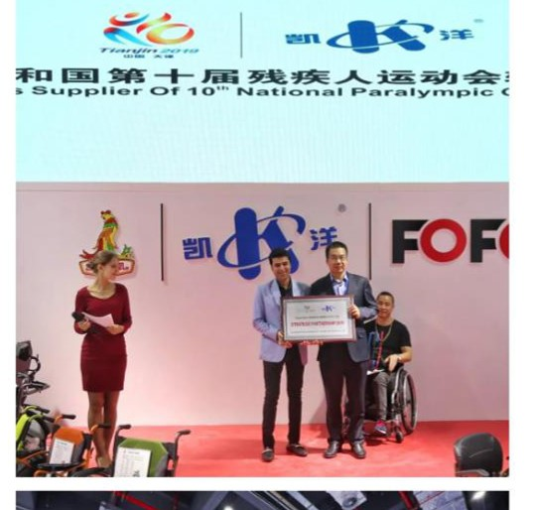
News Report
Joint venture with Guangdong kaiyang - the biggest wheelchair factory in China rowing fast , within 3 years become one of top 3 of Alternating pressure mattress factory in China and Taiwan .
Getting more and more attendtion from all over the world.
Become the most trustable and reputationed OEM/ODM factory .
FOFO

Slide 23
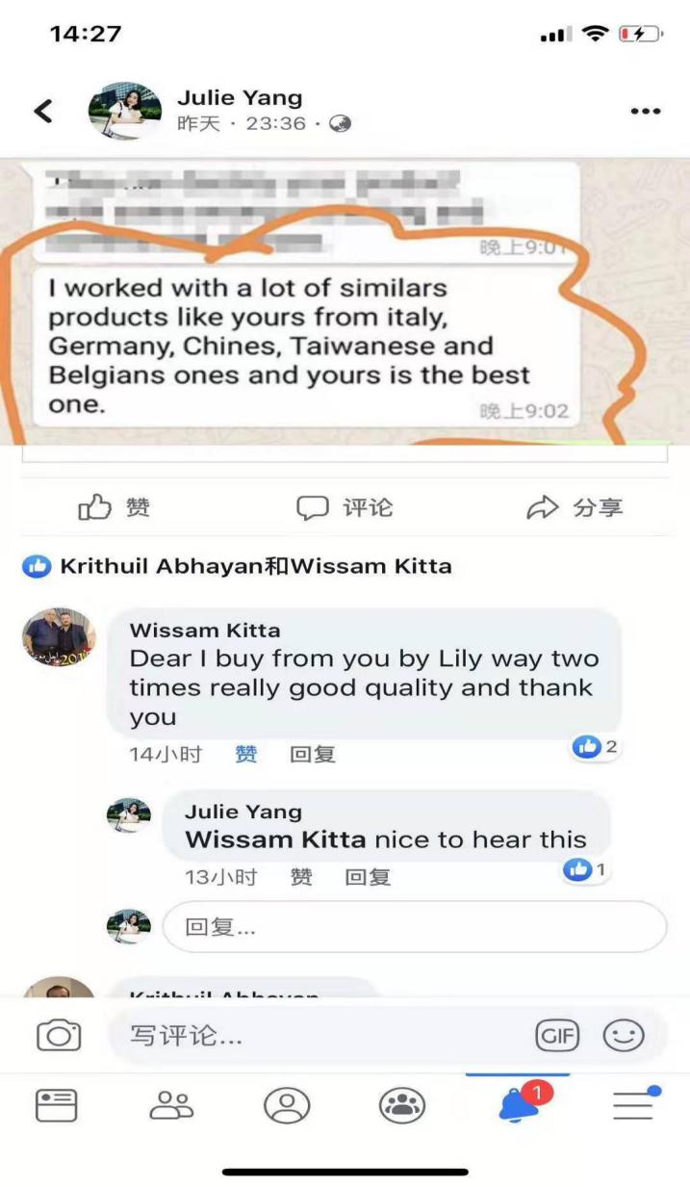
Customer feedback
Mattress after 3 years still using
“I worked with a lot of similars products like yours from Italy, Germany,Chinese, Taiwanese and Belgians ones and yours is the best one .”
TRUSTABLE
RELIEABLE

Slide 24
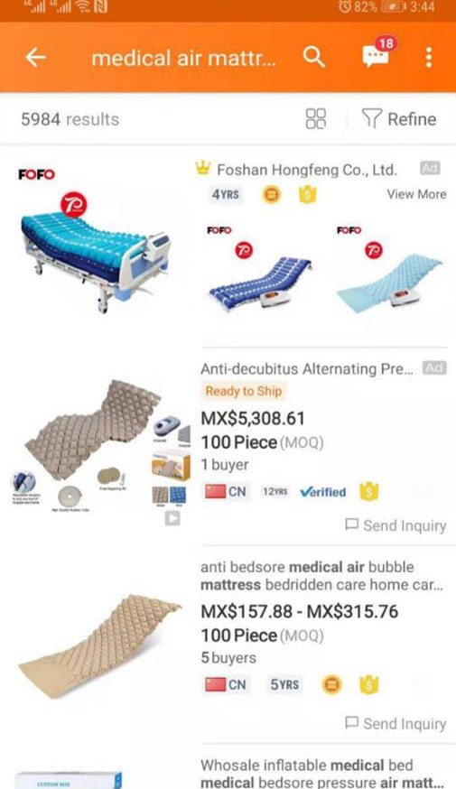
MEDICAL AIR MATTRESS
AIR COMPRSSION LEG MASSAGER
ALIBABA TOP 1
Medical air mattress and Air compression leg massager has become Alibaba APP TOP 1
Recovery Boots Become Alibaba PC TOP 1
AWESOME FEATURES
Keeping use taiwanese material , with over 20 years backgroud professional on High-frequency product . Our Mattresses and Air compression therapy system become OEM/ODM best choice
Viisting our Alibaba website for get newest models on time ! Alibaba Searching “FOFO medical”

Slide 25
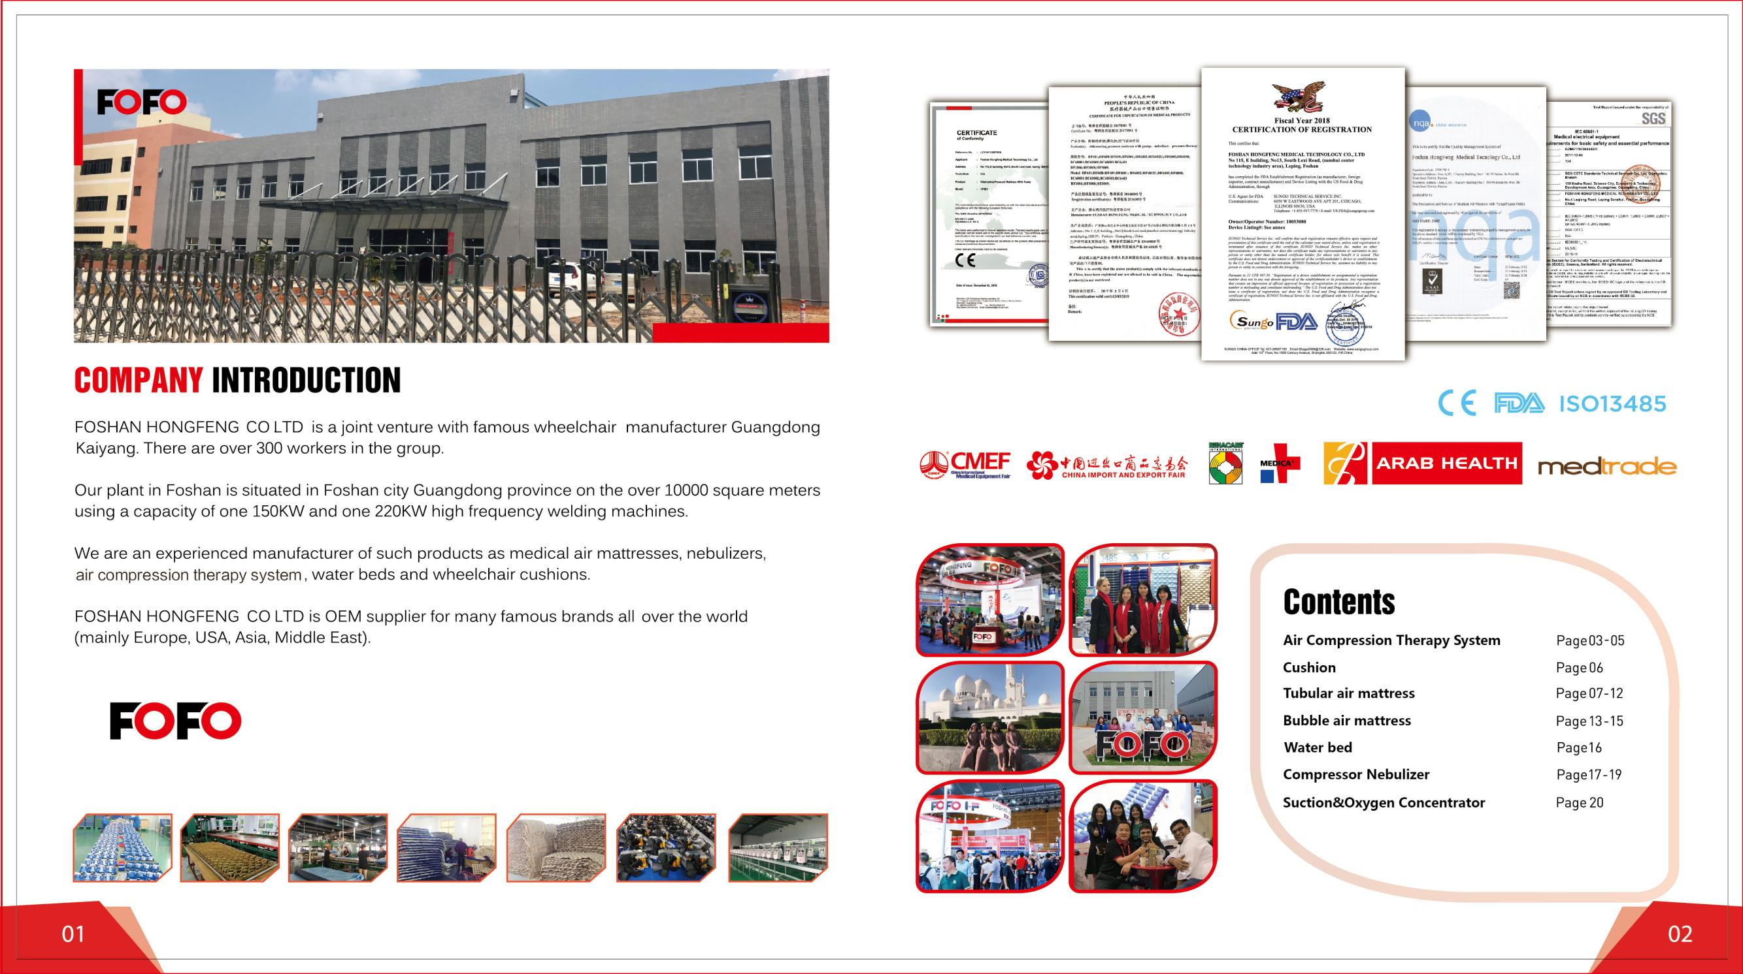
FOFO
Thanks for watching this !

